Slide 1
CRUDE OIL PRICE PREDICTION
Team members:
A.Sivasakthi
A.Afreen yusufa
B.Priyadharshini
S.Swetha

Slide 2
Abstract
Crude oil is world’s most leading fuel . some machine learning model fits the dataset efficiently depending upon the type of data points provided.
The main aim of the project is to find of the models that efficiently fit the data point and predict the price of fuel with the help of machine learning
This project aim to compare the different supervised learning models and bring a conclusion based on the efficiency

Slide 3
We have used 5 supervised learning models SVR (linear,RBF,polynominal),randomforestRegression-n,Linear Regression, to Know which gives best in terms of accuracy and performance
This has becomes a major problem in India where prices of IPG (liquefied petroleum Gas),petroleum, diesel have been increasing.
Hence these are derived or extracted from crude oil; India get its source of crude oil from neighboring countries like Dubai and Saudi-Arabia.
To predict the values of the petroleum and diesel in the mere future, we have decided to use the machine learning algorithm, which have given the most accurate result.
We have tried these algorithm which are mostly adaptive to many environments.

Slide 4
REFERENCE PAPERs
Y .Jevons Nagendra Kumar,parathaupreetham.2020”crude oil prediction in Deep Learning”. second International conference on Inventive Research in computing Application(ICIRCA).
P. Kiran varuma , p.Rohit ,p .Dlipi kumar2019”oil prediction usingArtifical Intellegence”.International Journal of scirnce and Engineering.
Shuang Gao ,yalinLin 2017”A new approach for crude oil predicition based on stream Learning”International Conference on Economic Management.
Hongtao Hu.Xiaojing Zhai2018”prediction method of crudeoil”second International conferences Inventive Rearch in Computing Application.
Parathu preetham ,Y.jeevan Nagendrea Kumar2019”predicition method of crude oil”International journal of science and Engineering (IJSE)
Xin gunan,G.Nagendra2018”prediction of crudeoil based on NeuralNetwork”Second International Conference on software Engineerind services.

Slide 5
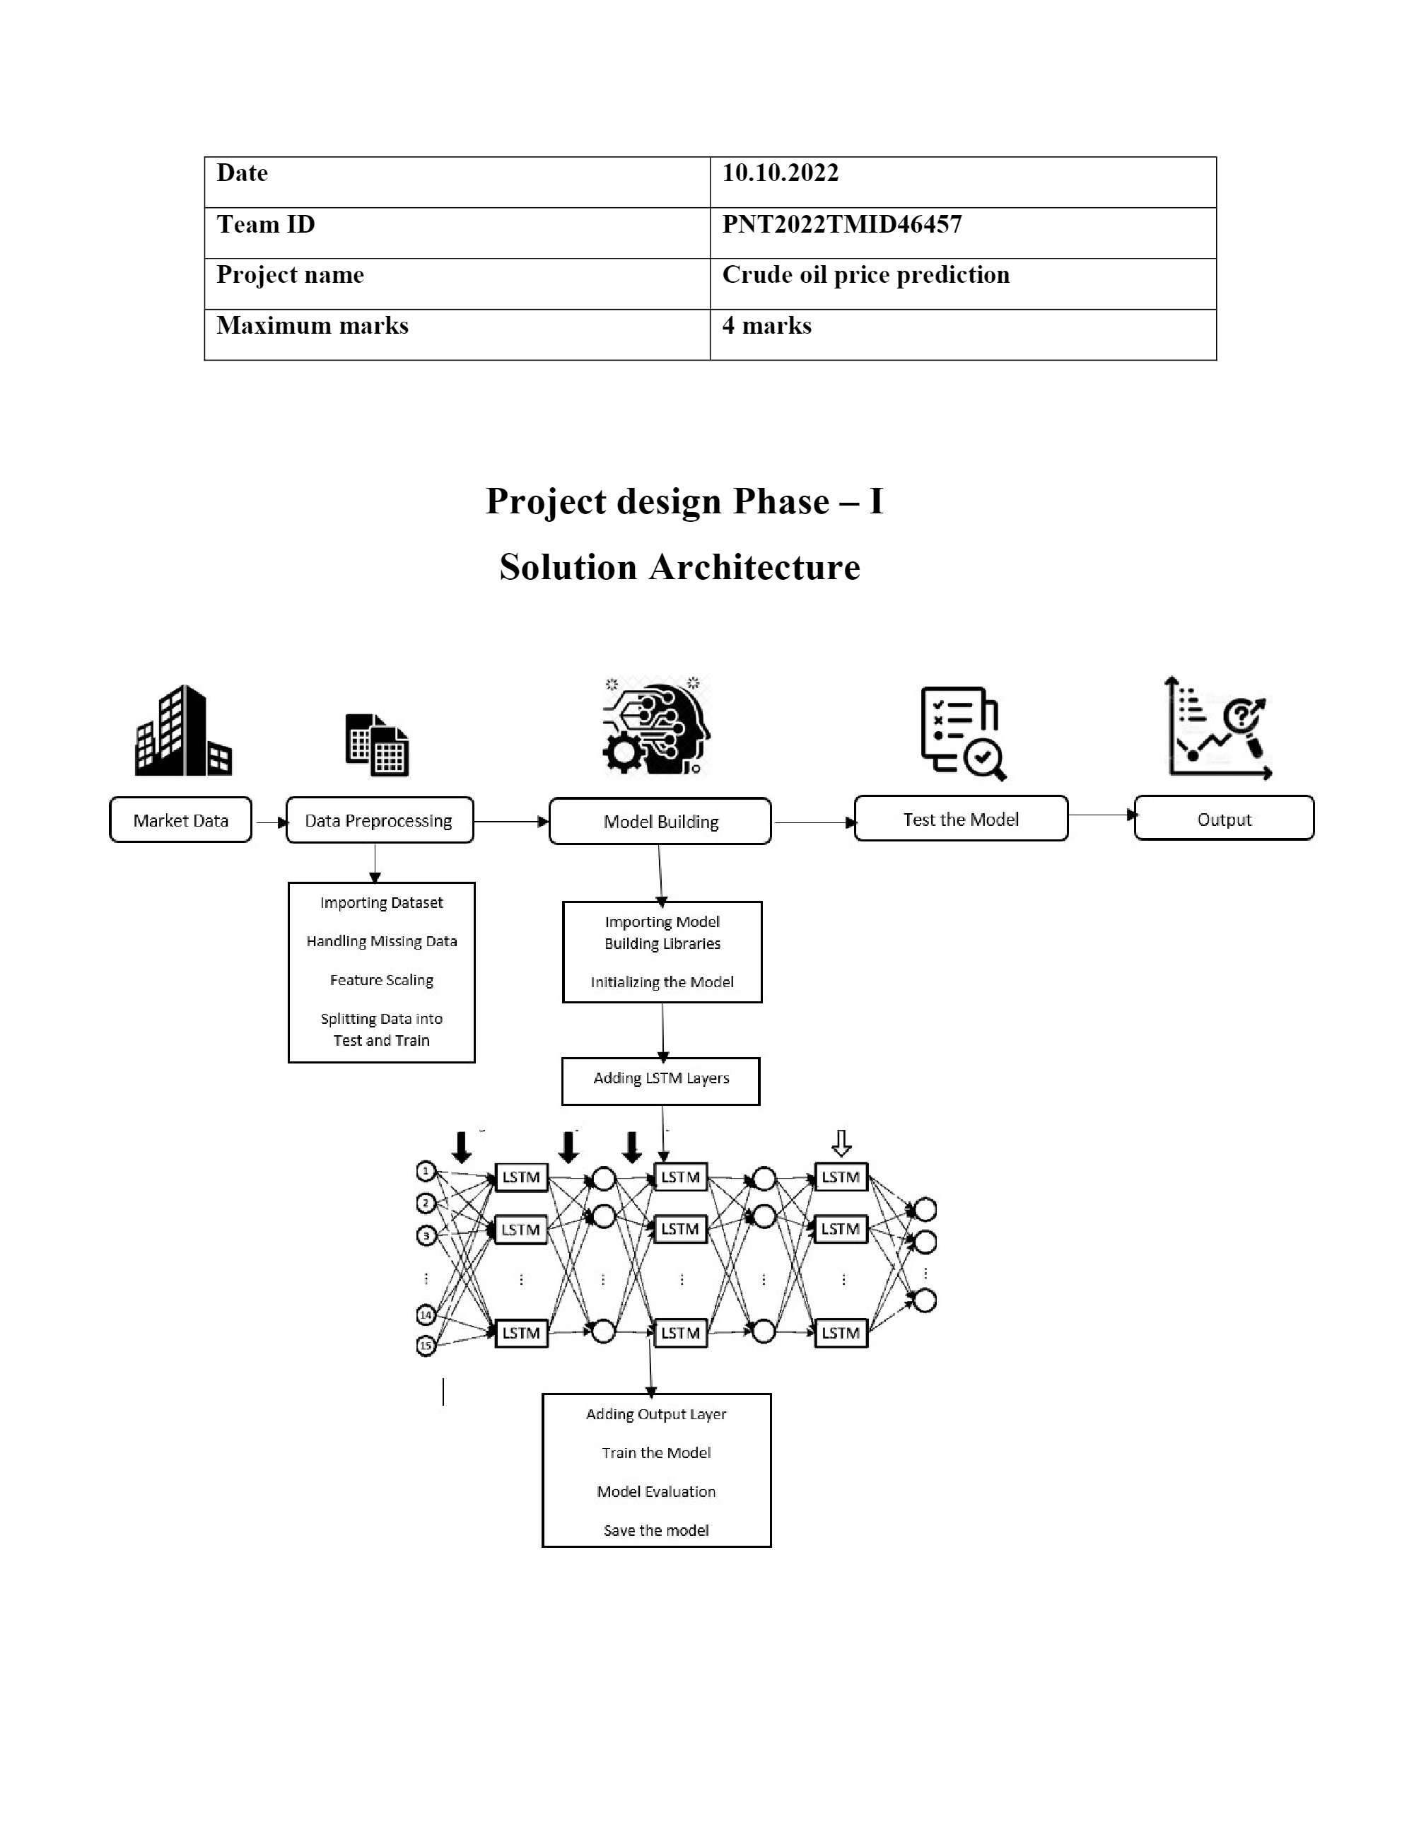

Slide 6
modules
Artificial Intelligence
IBM cloud
Watson studio
Python
Jupyter notebook
Provider
customer

Slide 7
Price prediction dataset
02-01-1986 25.56 25-10-1996 24.8 18-10-2007 89.48
03-01-1986 26 28-10-1996 24.75 19-10-2007 88.58
06-01-1986 26.53 29-10-1996 24.15 22-10-2007 87.6
07-01-1986 25.85 30-10-1996 24.4 23-10-2007 86.45
08-01-1986 25.87 31-10-1996 23.25 24-10-2007 88.3
09-01-1986 26.03 01-11-1996 23 25-10-2007 92.09
10-01-1986 25.65 04-11-1996 22.8 26-10-2007 91.73
13-01-1986 25.08 05-11-1996 22.65 29-10-2007 93.45
14-01-1986 24.97 06-11-1996 22.75 30-10-2007 90.33
15-01-1986 25.18 07-11-1996 22.8 31-10-2007 94.16
16-01-1986 23.98 08-11-1996 23.6 01-11-2007 93.53
17-01-1986 23.63 11-11-1996 23.35 02-11-2007 95.8

Slide 8
21.33 12-11-1996 23.4 05-11-2007 94.06
21-01-1986 20.61 13-11-1996 24.25 06-11-2007 96.65
22-01-1986 20.25 14-11-1996 24.35 07-11-2007 96.46
23-01-1986 19.93 15-11-1996 24.15 08-11-2007 95.51
24-01-1986 19.45 18-11-1996 23.85 09-11-2007 96.36
27-01-1986 20.87 19-11-1996 24.5 12-11-2007 94.4
28-01-1986 19.45 20-11-1996 23.75 13-11-2007 91.18
29-01-1986 19.61 21-11-1996 23.9 14-11-2007 94.02
30-01-1986 19.58 22-11-1996 24.15 15-11-2007 93.37
31-01-1986 18.95 25-11-1996 25.75 16-11-2007 94.81
03-02-1986 17.42 26-11-1996 23.7 19-11-2007 95.75
04-02-1986 15.58 27-11-1996 23.7 20-11-2007 99.16
05-02-1986 16.28 29-11-1996 23.7 21-11-2007 98.57
06-02-1986 16.6 02-12-1996 24.7 23-11-2007 98.24
07-02-1986 17.7 03-12-1996 24.8 26-11-2007 97.66

Slide 9
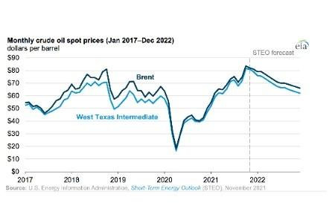
Price prediction

Slide 10
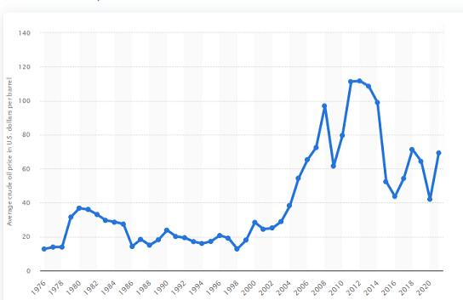

Slide 11
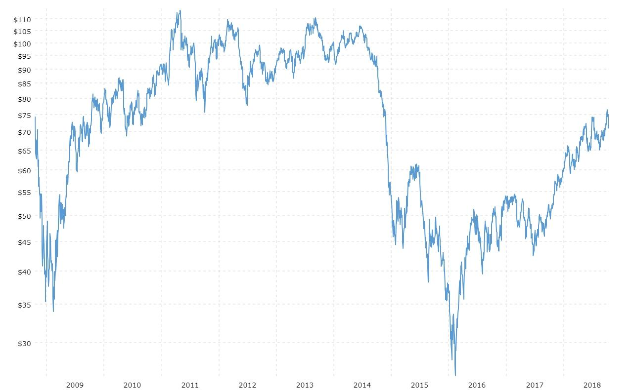

Slide 12
ALGORITHM USED
Optimized NeuralnetworkBP based on feural networkcluster algorithm.
Generic Algorithm.
Utilizing Gobal search abilityGeneric Algorithm.
Data screening abilityfuzzy cluster Algorithm.
Support vector machine and optimize Algorithm

Slide 13
ADVANTAGES
Increase in global demand for goods and services
Reduced OPEC’S global power
Benefits to some consumers
Reduction in commodity price
The value of demand is high

Slide 14
DISADVANTAGES
Due to the volatility the investors may find it difficult to earn returns
The price fluctuations of the crude oil price are highly unexpected
This causes various impacts on the oil importing countries
Sometimes difficulties in predict the value

Slide 15
Work done so far
Problem Statement
Brainstorm, Empathy Map
Literature Survey
Ideation
Crude oil prices Daily prices
Customer Journey
Project design Phase1
Milestone Activity List
Data flow diagram
Data Visualisation
Dataset_with_Sliding_windows
Feature Scaling
Hadling Missing Data

Slide 16
Import Libaries
Import Dataset
Splitting _ Data_ into_ Train_ and_Test
MODULING BUILDING
Adding_LSTM_Layer
Adding_Output_Layer
Configure_the_Learning_Process
Importing_Model_Building_Libraries
Initializing_The_Model
Model_Evalution
Save_the_Model

Slide 17
Test_The_Model
Train_the_model
Install Python Packages
Project knowledge
Model Evaluation
Project Flow
Project Structure
Integrate Flask with Scoring End Point
Register for IBM Cloud
Train ML model on IBM
Project development phase
Final submission

Slide 18


